Slide 1
ARICORE2I, CSCCORE2H, ECCCORE2H, ROBCORE2H (Intelligent Systems)
Predictive Analytics, Linear Regression and K Nearest Neighbours

Slide 2
What we’ve done so far
Introduction to AI and ML.
Categories and principles of AI.

Slide 3
Aims of this lecture
By the end of this lecture you should:
know the meaning of predictive analytics.
be aware of how linear regression works.
know how the K-NN algorithm works.
have the means and knowledge of use K-NN on a dataset.

Slide 4
PART 1: PREDICTIVE ANALYTICS

Slide 5
What is Predicative Analytics?
Learning from the future based on historical facts.
You have past data about something, e.g. the weather temperature for the past month.
You want to predict future data, such as the temperature tomorrow.
Encompasses several different methods, such as data mining, computational modelling, and machine learning.

Slide 6
Predictive analytics notation
Let us call your past data X.
Let us call the data you’re trying to predict y.
You’re assuming there’s some function that allows you to derive y from X. In other words, we want to map X to y as accurately as possible.
Maybe there is, or maybe there isn’t!
Let us call this function f().
So we need a predictive analytical method to simulate f as closely as we can, i.e. y = f(x).

Slide 7
Let’s draw it…

Slide 8
PART 2: LINEAR REGRESSION

Slide 9
What is linear regression?
Regression is a supervised learning approach.
Regression emerges from the discipline of statistics, and has grown to be important in ML.
It attempts to fit a line or curve to a dataset.
This line or curve is associated with an equation, and the goal is to find this equation.
This is known as fitting, as the fitted equation can be used to predict the label (i.e. the output) for new, unseen data.

Slide 10
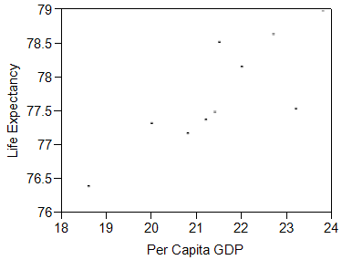
An example of data
Each point here represents a country.
Can you spot a trend?
Try to draw a best fit line through this data.

Slide 11
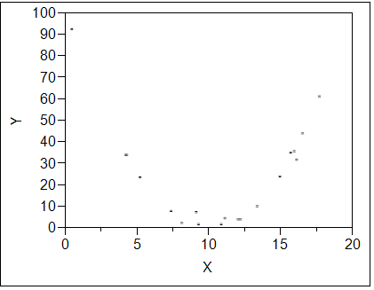
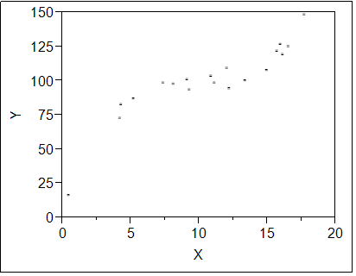
More examples
For which of the datasets below is linear regression appropriate?
How can the other datasets be fitted?
Is regression appropriate for all these datasets?

Slide 12
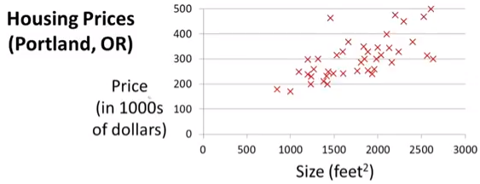
Regression variables
Can we describe the
behavior between
the two variables
with a linear equation?
The variable on the x-axis (Size) is often called the explanatory or predictor variable. This is the input variable.
The variable on the y-axis (Price) is called the response variable. This is the output variable, and the one we are trying to predict.

Slide 13
The main objective
The main objective is to predict the value of the output variable for given values of the input variable.
E.g., If we know the per capita GDP of a country, or the house size, can we predict life expectancy, or house price, respectively.
Note: The predictor variable does not necessarily cause the response.

Slide 14
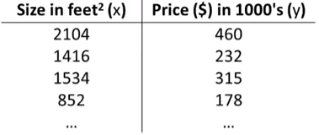
The data
Let’s look at the data for house prices:
Each row in this table:
is known as a training example.
corresponds to a point in the previous graph.
Notation so far:
x is the input variable.
y is the output variable.
m is the number of training examples (i.e. number of rows).

Slide 15
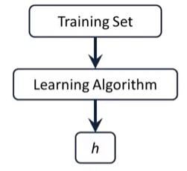
Hypothesis (h)
This term has a special meaning in ML.
It refers to the mechanism used to form the prediction.
In regression, the hypothesis (h) is the equation of the line passing through the point.

Slide 16
Line equation
The equation for a line is y=p₀+p₁x.
p₁ is gradient of the line. (This is its slope.)
p₀ is the point at which the line intersects the y-axis.
Note this is equivalent to the equation you might already be familiar with, y=mx+c.
The above line equation is the hypothesis for linear regression.
p₀ and p₁ are the parameters of the hypothesis. The objective is the find their values.

Slide 17
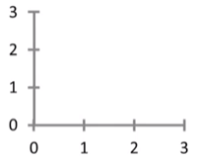
Example line equations
Let us draw us draw the lines corresponding to the following respective hypothesis parameters:
p0=1.5, p1=0
p0=0, p1=0.5
p0=1, p1 = 1
p0=-2, p1=3

Slide 18
Cost
The objective is to draw a line that best fits the data points.
We therefore need to find the values of p0 and p1 that result in this best fit line.
The cost is a measure of how badly the hypothesis fits the data.
I.e., how badly the line fits the data points.
This cost must be minimised.

Slide 19
PART 3: K Nearest Neighbours

Slide 20
What is K-NN
Type of supervised learning, mainly for classification.
Labelled data (i.e., testing data with defined categories or groups).
A way to determine the unknown label of a query point.
Operates by taking a vote from the K nearest neighbours.

Slide 21
K-NN in Predictive Analytics
We have past data, and have a data point of which we want to predict the label.
E.g., the label might be “will rain tomorrow” or “will not rain tomorrow”.
A trained K-NN learner will therefore act as the function f() that maps known data on unknown data.

Slide 22
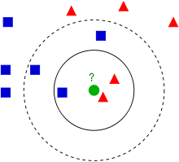
What does it give us?
The label of a new data point based on its nearest neighbours.

Slide 23
What are the advantages?
Simple to implement.
Flexible to feature / distance choices.
Naturally handles multi-class cases.
Can do well in practice with enough representative data.

Slide 24
What are the disadvantages?
Large search problem to find nearest neighbours.
Storage of data.
Must know we have a meaningful distance function.

Slide 25
Applications
Breast cancer diagnosis
https://www.ncbi.nlm.nih.gov/pmc/articles/PMC2243774/
Text categorisation:
http://www.cs.bilkent.edu.tr/tech-reports/1998/BU-CEIS-9809.pdf
Prediction of economic events: http://www.ijera.com/papers/Vol3_issue5/DI35605610.pdf
Medical data mining: https://www.researchgate.net/publication/270163293_Application_of_k-Nearest_Neighbour_Classification_in_Medical_Data_Mining

Slide 26
Overview (1)
Gather many training examples, determine what their features are, and plot them within a space with the same dimensionality as the number of features.
Each training example can be classified into one of N targets.
A testing example is given, that must be classified into one of the N targets.

Slide 27
Overview (2)
Choose a value k to be the number of neighbours to count.
Locate the k nearest neighbours of the unclassified example. Choose an odd k for a 2-class problem, but in general, k shouldn’t be a multiple of the number of classes.
So, in the training phase, choose different values for K and different training examples, examining the rates of correct/incorrect classification, and choose the value of K that misclassifies the fewest examples.

Slide 28
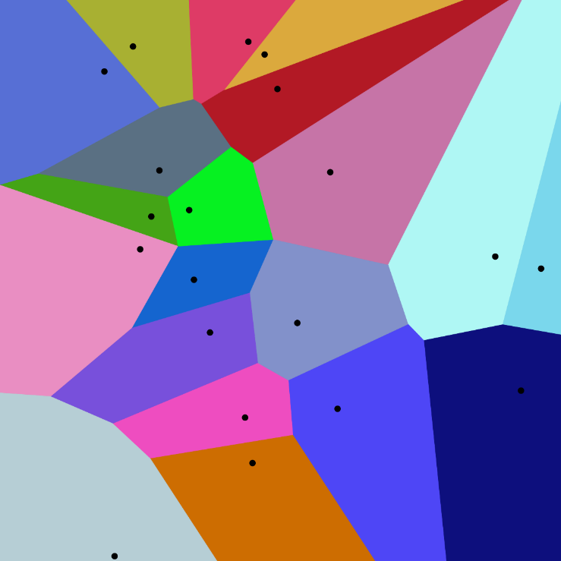
Remarks
We can think of 1-NN as the separation of regions of the search space as a Voronoi tessellation.
The edge of a Voronoi region can be a classification boundary.
K-NN is sensitive to outliers.

Slide 29
How to Use It!
Several methods:
Program it yourself, using a language and library of your choice, such as Java with DeepLearning4j, Python with Scikit-learn, etc, etc.
Use a commercial tool, such as Weka or Neuroph (both Java-based).
Use Hope Insight (created by me ☺)…

Slide 30
What we’ve covered today…
Overview of predictive analytics
Brief introduction to linear regression.
The K Nearest Neighbours Algorithm:
What it is and what it outputs.
Advantages and disadvantages.
Real-world applications.
Overview and relation to Voronoi tessellation.
Implementation and testing.

